Slide 1
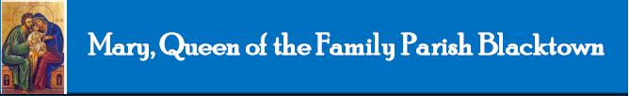

Welcome to St Michael’s
20th Sunday
Ordinary Time
Year B
You have entered a SACRED SPACE ... A SACRED TIME…
Please ensure all mobile phones are switched off.
Please be respectfully quiet as we prepare for our Celebration.
Notes:
Saturday 5.30PM First Sunday of Advent
16th Sunday in Ord Time Year B

Slide 2
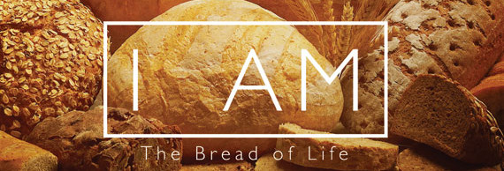
Jesus said to the crowd: ‘I am the living bread which has come down from heaven. Anyone who eats this bread will live for ever.’

Slide 3
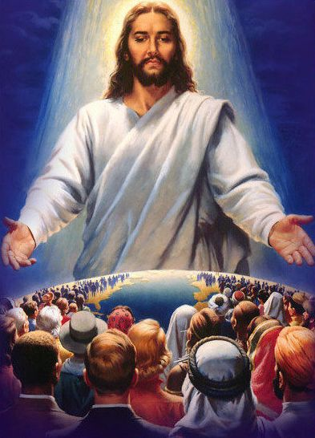
‘…and the bread that I shall give
is my flesh, for the life of the world.’

Slide 4
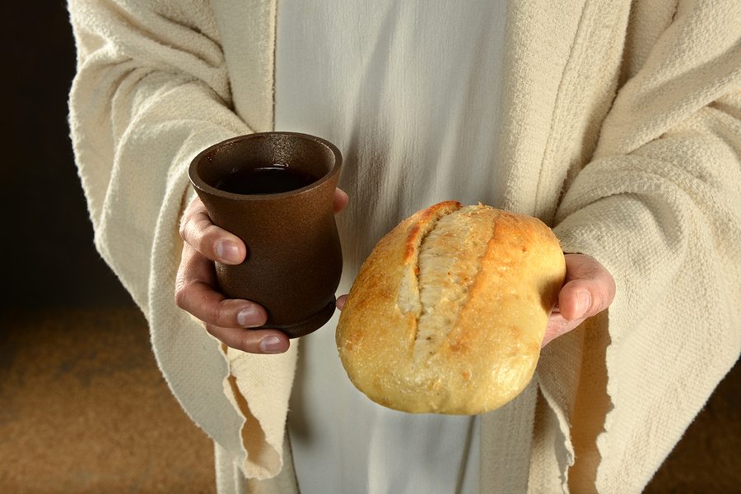
“He who eats my flesh and drinks my blood lives in me and I live in him.”

Slide 5
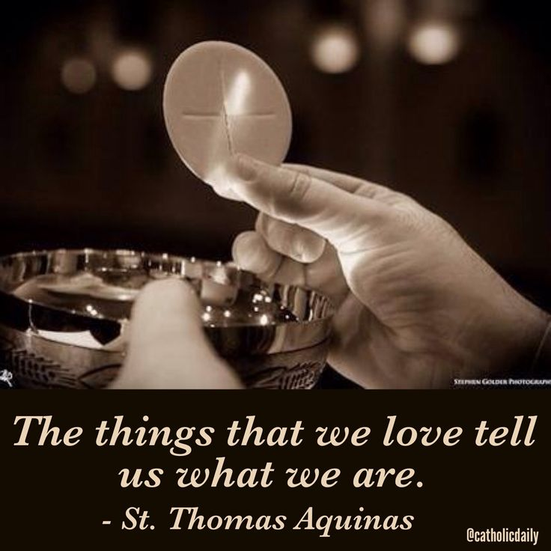
St Thomas Aquinas reminds us

Slide 6
PLEASE STAND

Slide 8
Penitential Act
Lord have mercy. Lord have mercy.
Christ have mercy. Christ have mercy.
Lord have mercy. Lord have mercy.
The English translation of The Roman Missal © 2010,
International Commission on English in the Liturgy Corporation. All rights reserved.

Slide 10
GLORIA
Glory to God in the highest,
and on earth peace to people of good will.
We praise you,
we bless you,
we adore you,
we glorify you,
we give you thanks for your great glory,
Lord God, heavenly King,
O God, almighty Father.

Slide 11
Lord Jesus Christ, Only Begotten Son,
Lord God, Lamb of God, Son of the Father,
you take away the sins of the world,
have mercy on us;
you take away the sins of the world,
receive our prayer;
you are seated at the right hand of the Father, have mercy on us.

Slide 12
For you alone are the Holy One,
you alone are the Lord, you alone are the Most High,
Jesus Christ, with the Holy Spirit,
in the glory of God the Father.
Amen.
The English translation of The Roman Missal © 2010,
International Commission on English in the Liturgy Corporation. All rights reserved.

Slide 14

Responsorial Psalm
Taste and see the goodness
of the Lord.

Slide 15


Slide 16
Gospel Acclamation
Alleluia, alleluia!
All who eat my flesh and drink my blood live in me and I in them, says the Lord.
Alleluia!

Slide 18

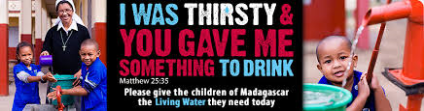
Speaker
followed by
Special Collection

Slide 20
APOSTLES’ CREED
I believe in God,
the Father almighty,
Creator of heaven and earth,
and in Jesus Christ, his only Son, our Lord,
(At the words that follow, up to and including the Virgin Mary, all bow.)
who was conceived by the Holy Spirit,
born of the Virgin Mary,
suffered under Pontius Pilate,
was crucified, died and was buried;
he descended into hell;

Slide 21
on the third day he rose again from the dead;
he ascended into heaven,
and is seated at the right hand
of God the Father almighty;
from there he will come to judge
the living and the dead.
I believe in the Holy Spirit,
the holy catholic Church,
the communion of saints,
the forgiveness of sins,
the resurrection of the body,
and life everlasting. Amen.

Slide 23
First Collection
This collection goes to the Bishop
for the support of the Diocese.
Thank you for your contribution

Slide 25
Holy, Holy, Holy
Holy, Holy, Holy Lord God of hosts,
Heaven and earth are full of your glory.
Hosanna in the highest
Blessed is he who comes
in the name of Lord,
Hosanna in the highest.
The English translation of The Roman Missal © 2010,
International Commission on English in the Liturgy Corporation. All rights reserved.

Slide 27
Save us, Saviour of the world,
for by your Cross
and Resurrection
you have set us free.
Memorial Acclamation
When we eat this Bread and drink this Cup, we proclaim your Death,
O Lord, until you come again.
We proclaim your Death, O Lord,
and profess your Resurrection
until you come again.
The English translation of The Roman Missal © 2010,
International Commission on English in the Liturgy Corporation. All rights reserved.
Notes:
Sunday 10AM First Sunday of Advent
7am - 14th Sunday in Ord Time
16th Sunday in Ord Time Year B

Slide 29
Amen
When we eat this Bread and drink this Cup, we proclaim your Death,
O Lord, until you come again.
Amen
We proclaim your Death, O Lord,
and profess your Resurrection
until you come again.
The English translation of The Roman Missal © 2010,
International Commission on English in the Liturgy Corporation. All rights reserved.
Notes:
Sunday 10AM First Sunday of Advent
7am - 14th Sunday in Ord Time
16th Sunday in Ord Time Year B

Slide 31
Lamb of God
Lamb of God, you take away the sins of the world, have mercy on us.
Lamb of God, you take away the sins of the world, have mercy on us.
Lamb of God, you take away the sins of the world, grant us peace.
The English translation of The Roman Missal © 2010,
International Commission on English in the Liturgy Corporation. All rights reserved.

Slide 33
Second Collection
What you contribute now
is for the support of our
parish and its mission.
Thank you for your generosity

Slide 35

Movie & BBQ,
7.00pm Friday 21 August
Fr Sid Moseley Centre
(St Michael’s)
MEET CHRIST:
BETWEEN ‘THE PUB AND THE PEW’

Slide 36

Certificate in
Pastoral Formation 2016
Early Bird Registrations Now Open
For further information contact the IFM or Parish Office

Slide 37
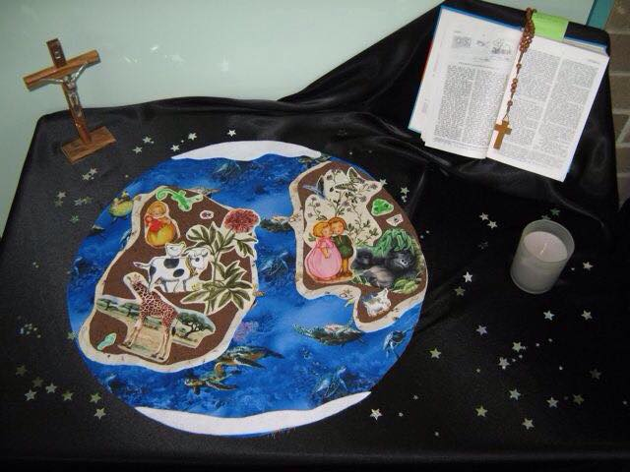
#prayerspacechallenge
Create a Prayer Space for your family.
Take a photo and upload it to our twitter feed; facebook page or email to us to upload.
Use the hashtag #prayerspacechallenge

Slide 38



www.mqofblacktown.org.au
    www.facebook.com/blacktowncatholics
@mqofblacktown

Slide 39
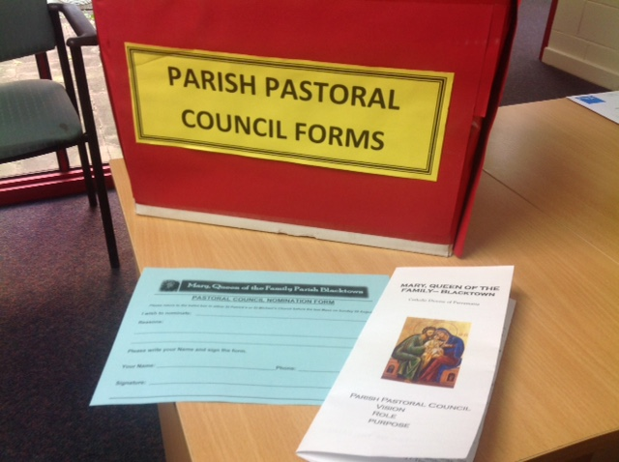
PARISH PASTORAL COUNCIL
Read Brochure
Pray and complete (blue)nomination form
Place form in Red Box at main door at each Church
Nominations close 7.00pm 29th August

Slide 44
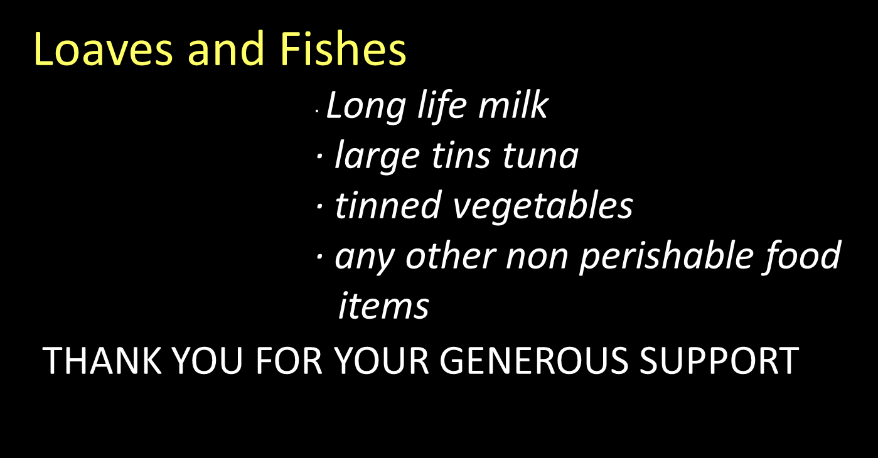

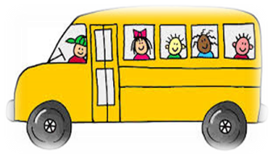
JEAN & BETTY’S BUS TRIPS
Come on a great trip to Adelaide for a fantastic time with fantastic people and make new friends
10 days starting 18 October. Approx 1750.00pp
Contact Jean 99203401 or 0425251754

Slide 45



JEAN & BETTY’S BUS TRIPS
JEAN & BETTY’S BUS TRIPS
Come on a great trip to Adelaide for a fantastic time with fantastic people and make new friends
10 days starting 18 October. Approx 1750.00pp
Contact Jean 99203401 or 0425251754

